Slide 1


Arrays in JavaScript

Slide 2
Objective
Introduction arrays.
Manipulating arrays.
Array destructuring
Sets

Slide 3

What is an array?
An array is an object which contains a list of values, each value is called an element, and each element has a numeric position in the array, known as its index.
let studentTickets = [10, 20, 15];
starting at index 0 and continuing to an index array.length – 1.
Can access a specific value stored in an array by using its position in the array or index:
studentTickets[0];
An element inside an array can be of any type, and different elements of the same array can be of different types.

Slide 4

Manipulating arrays
for loop:
let studentTickets = [10, 20, 15];
let ticketsPrice =0;
for (let i = 0; i < studentTickets.length; i++){
ticketsPrice += studentTickets[i]
console.log(i + " " +ticketsPrice)
}
console.log(ticketsPrice)
https://codepen.io/ecacosca/pen/KKqbQwP?editors=0011

Slide 5
Manipulating arrays
forEach:
let studentTickets = [10, 20, 30];
studentTickets.forEach(function(element) {
console.log(element);
});

Slide 6

Manipulating arrays
map:
const studentTickets = [50, 30, 25, 40];
const newPrice = studentTickets.map(discountFunction)
function discountFunction(num) {
var amount= num /100*15;
return num- amount;
}
console.log('MAP - Get array of price after discount 15%');
console.log(newPrice);

Slide 7
Manipulating arrays
const students = [
{
name: 'Majid',
height: 172,
mass: 77,
gender: 'male',
},
{
name: 'Ahmed',
height: 202,
mass: 136,
gender: 'male',
},
{
name: 'Noor',
height: 150,
mass: 49,
gender: 'female',
}
];
filter:
const allMaleStudents = students.filter(
(std) => std.gender === "male"
);
console.log("FILTER - Get all male students");
console.log(allMaleStudents);
console.log(allMaleStudents.map((s)=> s.name))

Slide 8
Important Array Methods
push(): Add an item to the end of an array.
indexOf(): Find the index of an element in an array.
slice(): Make a copy of an array.
reduce(): executes a reducer function for each value of an array. reduce() returns a single value which is the function's accumulated result.
sort(): method sorts the elements of an array.
reverse(): changes the sequence of elements of the given array and returns the reverse sequence.
find(): returns the value of the array element that passes a test.
shift():remove the first item of an array
Math.max and Math.min: the minimum or maximum element
splice(): method adds and/or removes array elements.

Slide 9
Concatenating Arrays
var array1 = [1, 2];
var array2 = [3, 4, 5];
var array3 = array1.concat(array2); // returns a new array
var array3 = [...array1, ...array2]
Results in a new Array:
[1, 2, 3, 4, 5]

Slide 10
Array destructuring
An array can be destructured when being assigned to a new variable.
const triangle = [3, 4, 5];
const [length, height, hypotenuse] = triangle;
length === 3; // → true
height === 4; // → true
hypotneuse === 5; // → true
Elements can be skipped
const [,b,,c] = [1, 2, 3, 4];
console.log(b, c); // → 2, 4
An array can also be destructured if it's an argument to a function.
function area([length, height]) {
return (length * height) / 2;
}
const triangle = [3, 4, 5];
area(triangle); // → 6

Slide 11
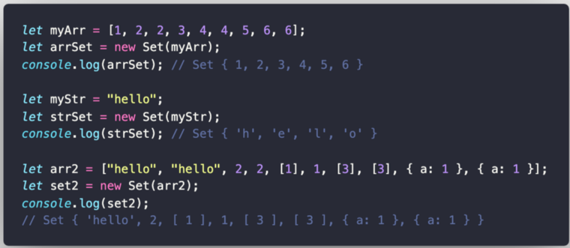
Sets
Like an array in that it stores a collection of items
Different from an array:
Stores only unique/distinct items. A set will, therefore, not store any duplicate values
Not indexed
Items in a set can’t be accessed individually

Slide 12
Resources
Can JavaScript Arrays Contain Different Types?
Work with JavaScript arrays like a boss
JavaScript Arrays

